Slide 1



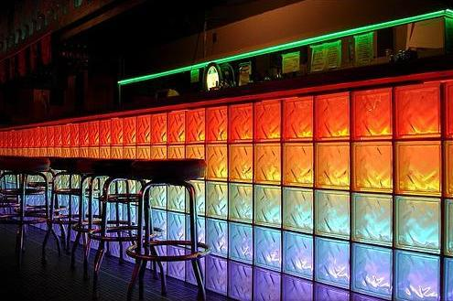
Reducing Alcohol Abuse in Gay Men:
Clinical Recommendations from Conflicting Research
Christopher W. Blackwell, Ph.D., ARNP, ANP-BC, CNE
Associate Professor & Coordinator of Nurse Practitioner Programs
UNIVERSITY OF CENTRAL FLORIDA
College of Nursing
Orlando, Florida
PROBLEM
While data indicate mental health and substance abuse disorders are more prevalent among gay men compared to their heterosexual counterparts, the literature assessing abuse of alcohol by gay men is conflicting
BACKGROUND & SIGNIFICANCE
Gay men have higher rates of mental health disorders including depression, suicide attempts, and substance abuse
Studies comparing the prevalence of alcoholism in
gay versus heterosexual samples have yielded mixed
results
National studies assessing alcohol abuse (eg. National Household Survey on Drug Abuse) do not assess sexual orientation
PURPOSE
This review focused on addressing these questions:
1) What specific conflicting data have been found in
various studies assessing alcohol use and abuse
in gay men?
2) What are the common themes and findings within
these studies?
3) What are the implications of internalized
homophobia and heterosexism as possible
etiologic factors for increasing the prevalence of
alcohol abuse among gay men?
FINDINGS
Research Question #1
Studies comparing the
prevalence of alcoholism
in gay versus heterosexual
samples have yielded mixed results:
11% vs. 19% (Stall & Wiley, 1988)
8% (Paul, Stall, & Bloomfield, 1991)
25% (Armadio & Chang, 2004)
Same rates as heterosexuals
(Morgenstern, et. al, 2001; Hughes, 2005)
21%
(Hatzenbuehler, Corbin, & Fromme, 2008)
40% (Wong, Kipke, & Weiss, 2008)
Research Question #2
Statistics available are limited to regional or local studies of specific populations
Differences in alcoholism between heterosexuals and homosexuals are not as dramatic as once hypothesized
Research Question #3
Studies assessing the relationship between alcohol abuse and internalized homophobia/heterosexism have yielded mixed results
CONCLUSIONS & CLINICAL IMPLICATIONS
Assess internalized homophobia with the Sexual Identity Distress Scale
Appropriate use of screening tools with strong validity and reliability (such as the CAGE questionnaire) and effective referral to treatment specialists educated and experienced in gay issues beneficial
METHODS
Design
Exhaustive Review of the Literature
Multiple databses accessed and evaluated:
CINAHL
EBSCOhost
MEDLINE/PubMed
Procedures
Literature review consisted
of articles published within
the last 20 years assessing
alcohol use in gay/bi men
from:
Nursing science
Medical science
Psychology
Social work
Sociology
Methodologies from articles were compared and scrutinized
Findings were contrasted and possible explanations for gaps and differences in data were provided based on methodological flaws and/or issues
Finding implications were examined with focus on the relationship between internalized homophobia, heterosexism, and alcohol use/abuse
Clinical recommendations, based on evidence, were provided to address alcohol use/abuse in gay men
Christopher.blackwell@ucf.edu

