Slide 1
Human Papilloma Virus and Anorectal Carcinoma Knowledge in Men who have Sex with Men
Christopher W. Blackwell, Ph.D., ARNP, ANP-BC, CNE
Assistant Professor, College of Nursing
Candace Eden, MSN, RN
Doctoral Candidate, College of Nursing
University of Central Florida
Orlando, Florida

Slide 2

Introduction
Increased prevalence of HPV associated anal cancer in MSM
Highly similar to dysplasia of the cervix in women
Anal cancer now more common than cervical cancer
Impetus for study: Little inquiry into assessing knowledge level of MSM re;
HPV, anorectal carcinoma, anorectal Pap screening
Can screening used for cervical cancer be used to detect anal cancer at early stages?

Slide 3
Role of HPV in Development of Anal Dysplasia
HPV most highly transmissible STD of this century in sexually active young people
Most anogenital HPV infections are transient, asymptomatic, and have no clinical consequences
However,
Males and females have a 75% chance of acquiring HPV in their lifetime
College males 20-24 have highest incidence of genital warts 90% of which are from HPV
Infection difficult to diagnose in males

Slide 4
Question
What is the estimated lifetime risk of genital HPV infection for a sexually active Male?
10%
25%
40%
50%

Slide 5
Prevalence of HPV in Male Population
Overall prevalence of HPV infection among heterosexual, homosexual and bisexual males is 50% nationally
(Giuliano, et al, 2010)
*Thus Scientific interest in HPV infection in males has increased in last few years

Slide 6
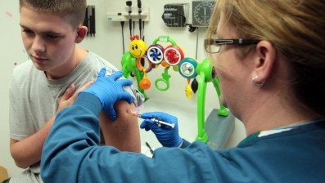
Public Transmission of HPV Knowledge
TV Campaigns now addressing HPV vaccination in males (9-26 years)
Public Agency Information (National Cancer Institute, Centers for Disease Control and Prevention) limited.
The CDC provides some facts addressing the impact of HPV on gay and bisexual men but has much more information available concerning females and HPV
Human Papilloma Virus (HPV) associated anal cancer is increasing in prevalence among men who have sex with men (MSM) and HIV-infected MSM (Chin-Hong, et al., 2004).
Do we employ large scale mandatory vaccine programs in either gender?
Notes:
October 27, 2005
6
Start of Literature Review:
1. Recent campaigns after release for vaccine for males in October of 2009 on television have addressed vaccination in male adolescents and young men (i.e., 9-26 years) to prevent genital warts but do not mention anal cancer or its prevalence in MSM2.
2. Information on the Internet available from public agencies such as the National Cancer Institute and the Centers for Disease Control and Prevention (CDC) regarding MSM and HPV is somewhat limited:
5. The lack of available information from public health resources regarding prevention strategies in males may be due partially to the complexity around the decision whether or not to employ large scale HPV vaccination programs in the male and female adolescent population (Liddon et al., 2010, Weiss, et al., 2010).

Slide 7
HPV Types & ACIP Recommendations 2010
HPV TYPES
Visible anogenital warts caused by HPV types 6 and 11
Most oncogenic HPV types 16 and 18 found in up to 70% of anogenital cancers
The Advisory Committee on Immunization Practices (ACIP)
guidelines have added information that MSM have a high
incidence of HPV types 6/11/16 and 18, but are cautious in
recommendations regarding vaccination in this group (FDA
Licensure, 2010).

Slide 8
Literature Review: HPV Knowledge Studies in Males
Men feel they have a lower risk for contracting STIs in risky sexual situations
Men have also consistently demonstrated a lower level of knowledge about HPV than women
Few studies have attempted to assess the knowledge base of MSM regarding HPV and their potential as carriers of this STI
Very little inquiry has been devoted to assessing the knowledge level of MSM regarding HPV, anorectal carcinoma, and anorectal carcinoma screening
Notes:
October 27, 2005
8
Men do not perceive themselves to be susceptible to HPV and have indicated they have a lower perception of risk for contracting
sexually transmitted infections (STIs) in risky sexual situations (Mehrotra, Noar, Zimmerman, & Palmgreen, 2009).
2. ( Liddon, Hood, Wynn, & Markowitz, 2010; Sandfort & Pleasant, 2009).
3. (Bertram & Niederhauser, 2008

Slide 9

HPV Knowledge In MSM Population
The knowledge level of MSM regarding HPV infection and its impact on them has been found to be low ( Pitts, Fox, Willis, & Anderson, 2007).
Gay men do have more of an awareness of HPV and the need for anal pap testing than bisexual men and are more likely to have disclosed their sexual orientation to their providers (Reed, Reiter, Smith, Palefsky, & Brewer, 2010).
HIV status appears to have a small positive impact on awareness and beliefs about HPV in MSM (Pitts et al., 2007; Reed et al., 2010) :
Notes:
October 27, 2005
9
3. HIV-infected MSM were found to have slightly higher (although still quite low) knowledge levels in a study conducted by Pitts et al (2007).

Slide 10
Problem Identification
To interrupt the transmission of HPV requires that MSM be knowledgeable about the infection, their susceptibility to acquiring it, and the availability of prevention strategies (Armstrong, 2010; Sandfort & Pleasant, 2009).
Notes:
October 27, 2005
10
1.

Slide 11
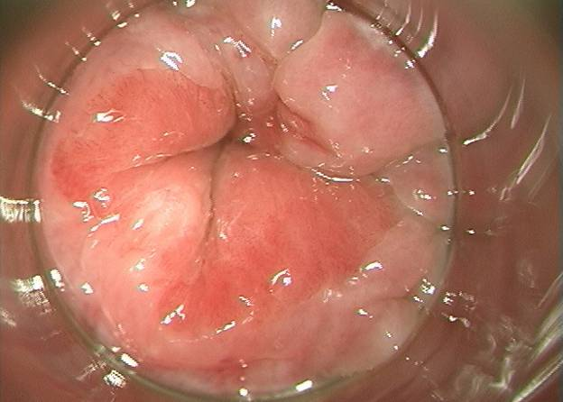
Anal Pap Screening
UCSF Anal Dysplasia Study
Normal Anorectal transformation zone
Notes:
This is normal anorectal tissue seen through an anoscope.
October 27, 2005
11

Slide 12
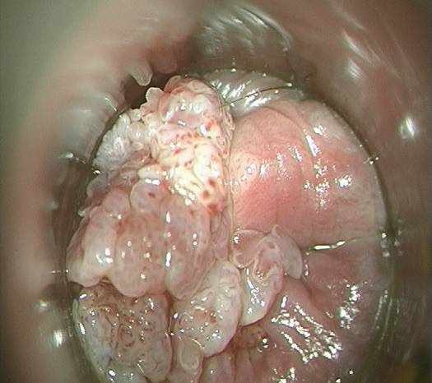
AnoRectal Condyloma / LSIL 1
UCSF Anal Neoplasia Study
Notes:
Taken by UCSF study by Jeff Logan

Slide 13
Literature Review: Screening Knowledge
Males do not always have symptoms of infection which may delay diagnosis
There are no evidence-based recommendations regarding who should and should not have screening (Blackwell, 2008)
Pilot study of gay and bisexual men’s knowledge about anorectal screening, indicated that men had little knowledge about anal pap testing.
Notes:
October 27, 2005
13
1. Because men who have HPV do not always have symptoms of the disease, the absence of visible genital lesions during a physical examination may preclude an accurate diagnosis (Bertram & Niederhauser, 2008, Sheng-Fei, & Winter, 2010).
3. A study following the pilot provided basic information to the participants about pap testing and assessed if they had ever had one, what barriers may prevent them from obtaining one in the future and who they thought should receive regular anal pap screening

Slide 14
MSM Anorectal Screening Knowledge
HIV infected males more likely to know about Pap screening availability Gay males more willing than bisexual males to have future screening
Males with HIV 10X more likely to also have HPV
Few studies have assessed HIV-infected MSM knowledge about anorectal screening and benefits of this preventative care measure
Notes:
1. The men in the study who were HIV- infected were more likely to be aware of anorectal screening. Gay men were more willing than bisexual men to have anal pap testing in the future (Reed et al., 2010).
2. Although there is evidence that MSM who are HIV-infected are the most at-risk group for HPV infection and anorectal cancer, few studies have assessed this group’s knowledge and awareness of their ability to have an anorectal screening and the benefits of this preventative care (Goldstone & Moshier, 2010).
October 27, 2005
14

Slide 15

Literature Review: Screening Knowledge
Intent for HPV testing in MSM positive if educated to their prevalence for anal cancer.
In one study over half of HIV-infected gay and bisexual men were willing to have the testing and pay for it without benefit of insurance (Reed et al., 2010).
MSM tend to be uninsured, But more likely to have regular yearly check-ups
Provides great opportunity for recommended STI screening
Notes:
October 27, 2005
15
The intent of MSM to have HPV testing is typically positive in studies that have evaluated the participants’ willingness to have it done once they have been educated about their vulnerability to anal cancer
they are more likely to have a regular yearly check-up which provides a great opportunity for recommended STI screening (Buchmueller & Carpenter, 2010)

Slide 16
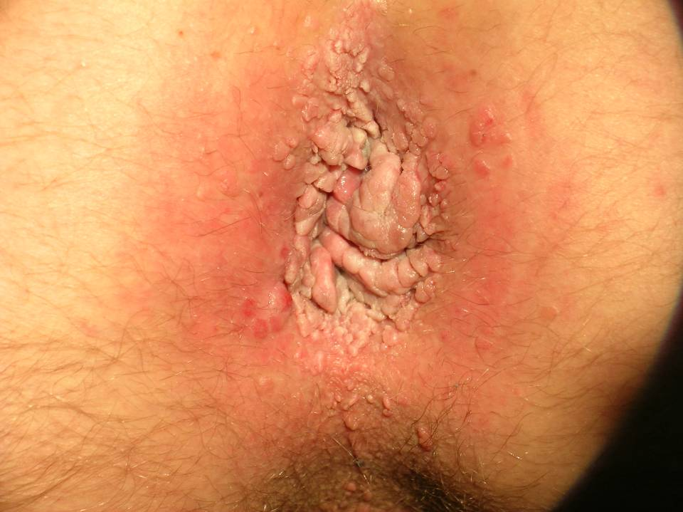

Slide 17
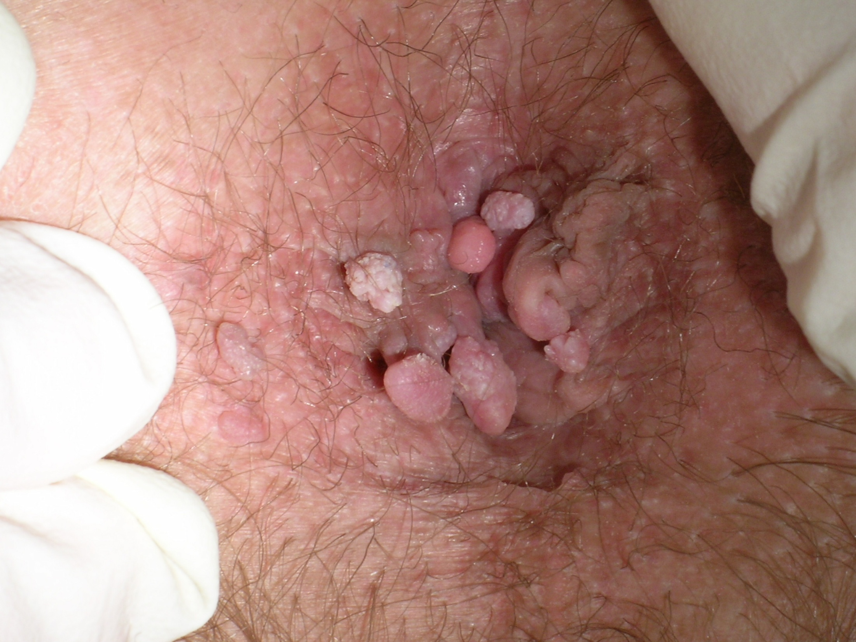
Notes:
From study by Jeff Logan, UCSF
October 27, 2005
17

Slide 18
Literature Review: Provider Role
Delay in diagnosis:
Symptoms of rectal bleeding, anal pain and irritation may be
misdiagnosed as hemorrhoids or other non-threatening illness
High risk groups may not be targeted due to unwillingness of gay or
bisexual patient to disclose sexual orientation to provider
The best way for health care providers to assess their patients’
medical needs is to inquire about their sexual behavior in a
nonjudgmental way; then if they identify as being gay or bisexual, to
provide education and recommended anorectal screening (Blackwell,
2008; Lindsey et al., 2009)
Notes:
October 27, 2005
18
Presentation of symptoms such as rectal bleeding, anal pain and irritation have sometimes been diagnosed by the provider as hemorrhoids or other non-threatening illnesses causing a delay in diagnosis (Lindsey et al., 2009
Identification of high risk groups that would benefit from recommended guidelines is critically important toward decreasing morbidity and mortality from HPV and anal cancer (Lindsey et al., 2009; Reed et al., 2010); but this is challenging in gay patients (Liddon et al., 2010).

Slide 19
Purpose of Study
The purpose of this pilot study was to determine the knowledge level of a sample of MSM regarding HPV, anorectal carcinoma, and screening and to determine the amount of knowledge obtained about these topics from healthcare providers.
Notes:
October 27, 2005
19

Slide 20
Research Questions
1) What is the knowledge of MSM about
HPV, anorectal carcinoma, and screening?
2) How many MSM have been screened and/
or are aware of the need for anal Pap
smear screening?
3) From what sources did MSM obtain
information on the need for anal Pap
smear screening?
Notes:
October 27, 2005
20

Slide 21
Methods
Methods, Sample, and Protection of Human Subjects:
Approval for study by UCF IRB
Sampling:
2 day period during a promotional convention held during a gay pride event and during two meetings of a university GLBT student organization.
MSM attending the events were approached by either the primary investigator or a research assistant and asked to participate.
Those who agreed to participate were briefed about the study’s purpose and asked to complete a questionnaire assessing knowledge of HPV, anorectal carcinoma, and screening.
Only men who reported sexual activity with another man during their lifetime were asked to participate in the study.
Informed consent was implied with the completion of the questionnaire. At the end of the data collection period, 89 participants had completed the questionnaire.
Notes:
October 27, 2005
21

Slide 22
Methods
Instrument:
The survey questionnaire was used in a similar study conducted in 2007 by Pitts and colleagues to assess knowledge of HPV, anorectal carcinoma, and screening in an Australian sample of MSM recruited from a gay pride event.
Permission to use the original instrument was obtained from Pitts.
The instrument was designed from a survey instrument used to assess knowledge of HPV, cervical cancer, and screening in women (Pitts et. al, 2007).
Participants answered demographic questions by either writing in answers on blank lines (e.g., age, ethnicity, number of visits to primary care provider, etc.) or selecting from provided options (e.g., employment status, sexual orientation identity, HIV status).
The entire survey consisted of 65 items:
38 items assessing knowledge were answered either true or false (19 items) or in Likert format (19 items ranging from 1 [strongly disagree] to 5 [strongly agree]).
Because the survey is identical to one used in a very similar prior research study assessing a sample with very similar characteristics, it was found to have strong inter-rater validity and reliability.
Notes:
October 27, 2005
22

Slide 23
Data Analysis
Data were coded and entered into a database using the Statistical Program for the Social Sciences (SPSS) 16.0.
Descriptive statistics were used to assess demographic characteristics of the sample and to answer the research questions.
Calculation of the mean number of participants who answered each item correctly was used to analyze the items assessing knowledge of HPV and anorectal carcinoma.
To determine if differences existed between participants recruited from the two different sources used to derive the sample, two-tailed t-tests were used to assess responses.
Notes:
October 27, 2005
23

Slide 24
Results
The final sample consisted of 89 MSM who identified as either gay (n = 85, 97%) or bisexual (n = 3, 3%).
Fifty-one (57.3%) of participants were recruited from the gay pride event, while the remaining 38 (42.7%) were from the GLBT student organization.
Although the mean age for those recruited from the GLBT student organization was 22 and the mean age from the gay pride event was 39, the sample was relatively homogenous:
Statistically significant differences between the groups were not found on any of the survey elements.
The average participant was 32 years of age, Caucasian, single, employed full-time, had completed his undergraduate education, and reported a negative HIV serostatus.
Sample characteristics presented in Table 1 in handout packet.
Notes:
October 27, 2005
24

Slide 25
Results: Research Questions
1) What is the knowledge of MSM about HPV, anorectal carcinoma, and screening?
Only 8 (27.7%) of the 28 items assessing knowledge about HPV, anorectal carcinoma, and screening had mean correct scores of 50% or more.
These items were all true/false-type questions and related to gender-associated HPV infection risk (items 14, 15, and 16), HIV-infection associated risk (item 17), treatment opportunity (items 20 and 24), screening need (item 21), and protection provided by the use of condoms (item 28).
Notes:
October 27, 2005
25

Slide 26
Discussion
The majority of knowledge items on the questionnaire had very poor results, with just eight of the items having a mean correct score of 50% or more.
Knowledge deficits among MSM regarding HPV, anorectal carcinoma, and screening are great.
Participants scored poorly on questionnaire items assessing knowledge about:
Pathophysiology of HPV
Technical procedure and facts about anal Pap screening
Risk factors for acquisition of HPV and anorectal carcinoma
HPV infection prevention methods.
Notes:
October 27, 2005
26

Slide 27
Discussion
Although their sample was much larger (n = 384) these findings are very similar to the work of Pitts et al. (2007):
Most participants had knowledge deficits about these same topics.
In fact, 19% of their sample actually answered every HPV knowledge item incorrectly.
These findings indicate a significant need for both primary care providers and public health practitioners to educate their MSM patients about the pathophysiology of HPV, the relationship between HPV and anorectal carcinoma, and the facts about anorectal pap screenings.
The CDC (2010b) has excellent teaching tools which can be used by providers to educate patients about HPV:
HPV: Common Infection, Common Reality is available for download from the CDC’s Web site (English: http://www.cdc.gov/std/hpv/common-infection/Bro-br.pdf; Spanish: http://www.cdc.gov/std/hpv/common-infection/sp/Bro-Sp-br.pdf) and provides answers to both men and women about the epidemiology of HPV, risk factors, prevention methods, and the relationship between HPV and HPV-associated cancers.
HPV and Men: Fact Sheet (CDC, 2010a), available at (http://www.cdc.gov/std/hpv/stdfact-hpv-and-men.htm ) discusses many of the implications for HPV in MSM, particularly anorectal and other HPV-associated cancers.
Notes:
October 27, 2005
27

Slide 28
Discussion
Only 6 (6.7%) of the men in this sample had ever had anal Pap screening.
Forty-nine (55.1%) participants had never heard of an anal Pap smear.
Of those who had, just 29 (32.6%) received this information from a healthcare professional.
Pitts et al. (2007) also found that most participants were rarely screened nor educated about these issues from their healthcare providers:
Over half of the Australian sample had never heard of an anal Pap test and were confused about the prevalence of HPV in women versus men.
Only 14.3% of the sample had been screened with an anal Pap test.
Notes:
October 27, 2005
28

Slide 29
Discussion: Providers
Providers should question all patients about their sexual history in a non-judgmental manner and should make no assumptions about anyone’s sexual orientation (Reed, et al., 2010).
Recommendations are conflicting regarding the widespread implementation of anal Pap screening in MSM.
Many health authorities support annual anal Pap screenings in this population (CDC, 2010a).
Regardless, it is important for providers to assess patient risk for HPV infection when considering screening approaches:
Assessment of the patient’s consistent use of condoms during anal sexual intercourse and his number of sexual partners is essential.
Clinicians should learn the proper technique for screening MSM for anorectal carcinoma and review the relevant literature about the topic:
An article by Blackwell (2008) provides an overview of the clinical importance of screening MSM using anal Pap smears and also describes its technical procedure.
Notes:
October 27, 2005
29

Slide 30
Discussion: Public Health
Public health officials and practitioners could target events with large numbers of MSM attendees and provide brochures and educational information about HPV, anorectal carcinoma, and screening methods.
In addition, sexual networking sites are becoming a more prevalent means for MSM to meet sexual partners and could be leveraged as educational and informational venues (Blackwell, 2010).
Perhaps county, state, and national health authorities could design banner ads and other on-line information campaigns for MSM to place on these sites with the aim of providing education about these topics.
Such embedded interventions in these on-line environments have been effective toward encouraging syphilis screening for high-risk MSM (Klausner, Levine & Kent, 2004) and could provide similar results.
Notes:
October 27, 2005
30

Slide 31
Future Research and Nursing Education
Research in general with gay populations is difficult.
Because homosexual and bisexual orientations still carry social stigmatization, participants may be reluctant to participate in studies about sexuality and STIs.
Despite these challenges, it is essential for nurse scientists to persevere and design studies with a high amount of scientific rigor.
Future research on this topic should focus on national samples of MSM.
There should also be a focus on physicians’, nurses’, and other frontline primary care providers’ knowledge about these topics and their beliefs and attitudes about providing services to MSM along with preferred practice patterns in screening for STIs.
Educational in-services, continuing education activities, and conference presentations designed to augment provider knowledge on the topic are effective strategies to increase knowledge among clinicians.
Also, nurse educators should strive to include topics about GLBT health in undergraduate and graduate curricula to ensure that future nurses are educated about topics in cultural diversity inclusive of GLBT-related health content.
Notes:
October 27, 2005
31

Slide 32
Limitations
Perhaps the most significant limitation was its small sample size (n = 89) and isolated sampling location.
Attempts were made to include as many participants as possible, yet only 89 MSM agreed to participate and were from similar demographic and geographic backgrounds. Therefore, generalizability of results is limited.
In addition, study findings and implications are limited by the responses provided by participants:
It is assumed that participants provided honest answers.
Although data were anonymous, it is possible that some participants may have been concerned about revealing their sexual orientation and sexual history and, therefore, provided answers which may not have been entirely truthful.
However, this is a limitation noted in all research with stigmatized groups and vulnerable populations.
Notes:
October 27, 2005
32

Slide 33
Clinical Considerations
MSM have limited knowledge of need for anal Pap screening therefore, may not disclose sexual orientation to provider
HIV-infected males have 10X higher incidence of HPV infection so providers need to be attuned to need for anal smear screening
This study encourages open provider-patient discussion about sexual health, sexual orientation and need for STI screening
Nurses and physicians have a direct influence on MSM obtaining anal screening to limit their mortality and morbidity.

Slide 34
Clinical Considerations
Screening for HPV in women has reduced Cervical cancer by 75%
The same strategy needs to be applied to MSM to impact a reduction in anal cancer
Nurse educators should attend community events that are a draw to this population to provide in the moment HPV/anal cancer education
Specific education needs of this population are to encourage regular physician visits and tools to facilitate open discussion with their provider re: STI screening

Slide 35
Summary and Conclusions
Effective screening exists as a great preventative measure against anal cancer
The MSM population is one that can be targeted for HPV vaccination to increase “herd immunity”
Within this sample of MSM evidence indicates there was limited knowledge about HPV and the need for anal screening
MSM have little discussion with their healthcare providers on these relevant health topics and therefore do not receive the healthcare they need

Slide 36
Summary and Conclusions
Provider awareness and encouragement of their patients to disclose sexual practices needed so education and appropriate testing can be done
Community outreach for this population to provide much needed education an opportunity for health prevention in this population
Continued rigorous research studies needed in this population from the nursing scientific community to understand unique MSM health needs

Slide 37
Acknowledgements
This work was partially-sponsored by research grants funded by the Sigma Theta Tau International Honor Society of Nursing (Theta Epsilon), the Evelyn Frank McKnight Research Fund through the Florida Nurses Foundation, and the College of Health & Public Affairs at the University of Central Florida.
Notes:
October 27, 2005
37

Slide 38
Human Papilloma Virus and Anorectal Carcinoma Knowledge in Men who have Sex with Men
Christopher W. Blackwell, Ph.D., ARNP, ANP-BC, CNE
Assistant Professor, College of Nursing
Candace Eden, MSN, RN
Doctoral Candidate, College of Nursing
University of Central Florida
Orlando, Florida

