Slide 1
Infectious Disease Update: Managing Common Infections in the Nephrology Patient
Christopher W. Blackwell, Ph.D., ARNP, ANP-BC, CNE
Associate Professor and Coordinator of Nurse Practitioner Programs College of Nursing
University of Central Florida
Orlando, Florida

Slide 2
Infection and Renal Disease
ID in the Nephrology Patient:
Patients with CKD and end stage renal disease (ESRD) receiving dialysis have a higher rate of infection than individuals without kidney disease
Higher rates of pneumonia and sepsis than individuals without CKD

Slide 3
Infection and Renal Disease
ID in the Nephrology Patient (Ctd):
An incident cohort of patients beginning dialysis was found to have a 1-year incidence of infection related hospitalization of 32% if receiving hemodialysis and 24% if receiving peritoneal dialysis
Risk seems to increase with time on dialysis

Slide 4
Infection and Renal Disease
Catheter-related infections account for 250,000 serious infections every year
Of these, 31,000 infections result in death
Hospitals are required to publicly report preventable infections and infection related deaths
Hemodialysis clinics are not required to publicly report their infection rates

Slide 5
Infection and Renal Disease
At present, only evidence of surveillance and quality improvement initiatives is required by the Centers for Medicare and Medicaid (CMS) Conditions for ESRD Coverage
Public reporting of catheter-related infection rates to the National Healthcare Safety Network (NHSN) is voluntary
Only a small percentage of hemodialysis facilities participate in the NHSN program

Slide 6
Infection and Renal Disease
State surveyors and ESRD networks that monitor hemodialysis facilities approximately every three years review infection incidence surveillance reports
Public reporting on the CMS Dialysis Facility Compare Web site is limited to only three quality performance measures: a) anemia, b) dialysis adequacy, and c) patient survival, but it does not include infection rates

Slide 7
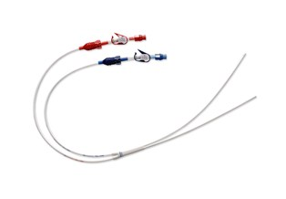
Infection and Renal Disease
Infection is the second leading cause of death in patients on hemodialysis; and for the majority of those infections, the access is usually implicated as the source for the infection

Slide 8
Dialysis Access Infection
Avoiding catheter-related bacteremia should be the highest priority for hemodialysis facilities
New guidelines to reduce catheter-related bloodstream infections were published April 1, 2011 (CDC, 2011)
Use of these guidelines has proven to be effective in reducing catheter-related blood stream infections within hospital based intensive care units by 58% from 2001 to 2009

Slide 9
Dialysis Access Infection
The Agency for Healthcare Research and Quality (AHRQ) estimates that this reduction saved an estimated 6,000 lives and approximately $414 million in extra costs
But could these measures work in hemodialysis facilities?
Hemodialysis facilities are very different from intensive care units (such as staffing ratios, environment, and structure)
Structural barriers need to be recognized and discussed openly to direct change

Slide 10
Epidemiology
In the United States, 15 million central vascular catheter (CVC) days (i.e., the total number of days of exposure to CVCs among all patients in the selected population during the selected time period) occur in intensive care units (ICUs) each year
Catheter related bloodstream infections (CRBSIs) independently increase hospital costs and length of stay, but have not generally been shown to independently increase mortality
While 80,000 CRBSIs occur in ICUs each year, a total of 250,000 cases of BSIs have been estimated to occur annually

Slide 11

Purpose of Reducing CRBSIs
The effort to reduce CRBSIs should be
multidisciplinary, involving healthcare professionals
who order the insertion and
removal of CVCs, those personnel
who insert and maintain intravascular
catheters, infection control personnel,
healthcare managers including the chief
executive officer (CEO) and those who allocate
resources, and patients who are capable of assisting in
the care of their catheters

Slide 12
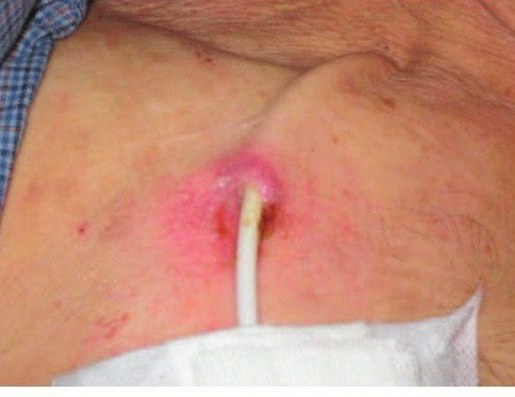
Objective of Prevention Program
The goal of an effective prevention program should be the elimination of CRBSI from all patient-care areas
Although this is challenging, programs have demonstrated success
Sustained elimination requires continued effort
The goal is to reduce the rate to as low as feasible
given the specific patient population being served,
the universal presence of microorganisms in the
human environment, and the limitations of current
strategies and technologies

Slide 13
CDC Guidelines
Intended to provide evidence-based recommendations for preventing intravascular catheter-related infections
Major areas of emphasis include:
educating and training healthcare personnel who insert and maintain catheters;
using maximal sterile barrier precautions during central venous catheter insertion;
using a > 0.5% chlorhexidine skin preparation with alcohol for antisepsis;
avoiding routine replacement of central venous catheters as a strategy to prevent infection; and
using antiseptic/antibiotic impregnated short-term central venous catheters and chlorhexidine impregnated sponge dressings

Slide 14

Epidemiology and Microbiology
The most commonly reported
causative pathogens remain
coagulase-negative staphylococci,
Staphylococcus aureus,
enterococci, and Candida
Gram negative bacilli accounted for 19%
and 21% of CLABSIs reported to CDC and the Surveillance
and Control of Pathogens of Epidemiological Importance
(SCOPE) database, respectively

Slide 15
Pathophysiology
There are four recognized routes for contamination of catheters:
Migration of skin organisms at the insertion site into the cutaneous catheter tract and along the surface of the catheter with colonization of the catheter tip; this is the most common route of infection for short-term catheters
Direct contamination of the catheter or catheter hub by contact with hands or contaminated fluids or devices;
Less commonly, catheters might become hematogenously seeded from another focus of infection; and
Rarely, infusate contamination might lead to CRBSI

Slide 16
Pathophysiology: CRBSI Considerations
Some catheter materials also have surface irregularities that enhance the microbial adherence of certain species (e.g., S. epidermidis and C. albicans )
Catheters made of these materials are especially vulnerable to microbial colonization and subsequent infection
Due to the formation of the fibrin sheath, silastic catheters are associated with higher risk of catheter infections than polyurethane catheters
On the other hand, biofilm formation by C. albicans occurs more readily on silicone elastomer catheter surfaces than polyurethane catheters
Modification of the biomaterial surface properties has been shown to influence the ability of C. albicans to form biofilm

Slide 17
Pathophysiology: CRBSI Considerations
S. aureus can adhere to host proteins (e.g., fibrinogen, fibronectin) commonly present on catheters by expressing clumping factors (ClfA and ClfB) that bind to the protein adhesins
Adherence is enhanced through the production by microbial organisms, such as coagulase negative staphylococci, S. aureus, Pseudomonas aeruginosa, and Candida species of an extracellular polymeric substance (EPS) consisting mostly of an exopolysaccharide that forms a microbial biofilm layer
This biofilm matrix is enriched by divalent metallic cations, such as calcium, magnesium and iron, which make it a solid enclave in which microbial organisms can embed themselves

Slide 18
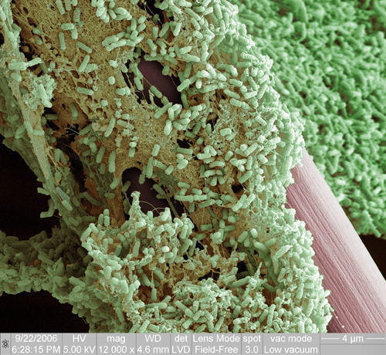
Pathophysiology: CRBSI Considerations
Such a biofilm potentiates the pathogenicity of various microbes by allowing them to withstand host defense mechanisms (e.g., acting as a barrier to engulfment and killing by polymorphonuclear leukocytes) or by
making them less susceptible to
antimicrobial agents (e.g., forming a
matrix that binds antimicrobials
before their contact with the organism
cell wall or providing for a population
of antimicrobial tolerant
"persister" cells)

Slide 19
Infection Prevention with Antimicrobials
Do not administer systemic antimicrobial prophylaxis routinely before insertion or during use of an intravascular catheter to prevent catheter colonization or CRBSI
Efficacy data are largely conflicting
Some studies have indicated decreases in infections while others have not
35% of patients in a study assessing oral prophylaxis with rifampin and novobiocin discontinued treatment due to toxicity
Heterogeneity in these studies precludes making any conclusion regarding efficacy

Slide 20
Infection Prevention with Antimicrobials
Use povidone iodine antiseptic ointment or bacitracin/ gramicidin*/polymyxin B ointment at the hemodialysis catheter exit site after catheter insertion and at the end of each dialysis session only if this ointment does not interact with the material of the hemodialysis catheter per manufacturer’s recommendation
* - US containing preparations do not include gramicidin

Slide 21
Infection Prevention with Antimicrobials
The application of bacitracin/gramicidin/polymyxin B ointment at the catheter insertion site was compared with placebo in 169 hemodialysis patients Infections were observed in more patients in the placebo group than in the bacitracin/gramicidin/polymyxin B group (34 versus 12%; relative risk, 0.35; 95% CI, .18 to .68)
The number of infections per 1,000 catheter days (4.10 versus 1.02; P < .0001) and the number of bacteremias per 1,000 catheter days (2.48 versus .63; P = .0004) were also greater in the placebo group

Slide 22
Infection Prevention with Antimicrobials
Within the 6-month study period, there were 13 deaths in the placebo group as compared with three deaths in the bacitracin/gramicidin/ polymyxin B group (P = .004)
Thus, there is evidence from one study in hemodialysis patients that bacitracin/gramicidin/ polymyxin B ointment can improve outcome, but no similar data exist for use in other patient populations
Outside of the US, this is essentially Polysporin® (US Polysporin® does not contain gramicidin)

Slide 23
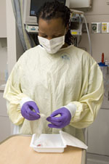
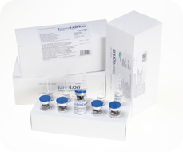
Infection Prevention with Antimicrobials
Use prophylactic antimicrobial lock solution in patients with long term catheters who have a history of multiple CRBSI despite optimal maximal adherence to aseptic technique
To prevent CRBSI, a wide variety of antibiotic and antiseptic solutions have been used to flush or lock catheter lumens

Slide 24
Infection Prevention with Antimicrobials
Catheter lock is a technique by which an antimicrobial solution is used to fill a catheter lumen and then allowed to dwell for a period of time while the catheter is idle
Antibiotics of various concentrations that have been used either alone (when directed at a specific organism) or in combination (to achieve broad empiric coverage) to prophylactically flush or lock central venous catheters include vancomycin, gentamicin, ciprofloxacin, minocycline, amikacin, cefazolin, cefotaxime, and ceftazidime; while antiseptics have included alcohol, taurolidine, trisodium citrate.

Slide 25
Infection Prevention with Antimicrobials
Although most studies indicate a beneficial effect of the antimicrobial flush or lock solution in terms of prevention of catheter-related infection, this must be balanced by the potential for side effects, toxicity, allergic reactions, or emergence of resistance associated with the antimicrobial agent
The wide variety of compounds used, the heterogeneity of the patient populations studied, and limitations in the size or design of studies preclude a general recommendation for use.
In addition, there are no FDA approved formulations approved for marketing, and most formulations have been prepared in hospital pharmacies

Slide 26
Infection Prevention with Antimicrobials
Do not routinely use anticoagulant therapy to reduce the risk of catheter-related infection in general patient populations
In a meta-analysis evaluating the benefit of heparin prophylaxis (3 units/mL in parenteral nutrition, 5,000 units every 6 or 12 hours flush or 2,500 units low molecular weight heparin subcutaneously) in patients with short-term CVCs, the risk for catheter-related central venous thrombosis was reduced with the use of prophylactic heparin. However, no substantial difference in the rate of CRBSI was observed.
Because the majority of heparin solutions contain preservatives with antimicrobial activity, whether any decrease in the rate of CRBSI is a result of the reduced thrombus formation, the preservative, or both is unclear

Slide 27
Infection Prevention with Antimicrobials
Do not routinely replace CVCs, PICCs, hemodialysis catheters, or pulmonary artery catheters to prevent catheter-related infections
Do not remove CVCs or PICCs on the basis of fever alone:
Use clinical judgment regarding the appropriateness of removing the catheter if infection is evidenced elsewhere or if a noninfectious cause of fever is suspected

Slide 28
Infection Prevention with Antimicrobials
Do not use guidewire exchanges routinely for non-tunneled catheters to prevent infection
Do not use guidewire exchanges to replace a non-tunneled catheter suspected of infection
Use a guidewire exchange to replace a malfunctioning non-tunneled catheter if no evidence of infection is present
Use new sterile gloves before handling the new catheter when guidewire exchanges are performed

Slide 29
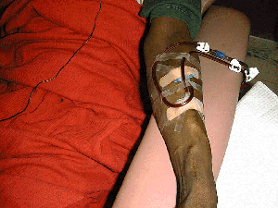
Infection Prevention with Antimicrobials
Hemodialysis Catheters:
The use of catheters for hemodialysis is the most common factor contributing to bacteremia in dialysis patients
The relative risk for bacteremia in patients with dialysis catheters is sevenfold the risk for patients with arteriovenous (AV) fistulas
AV fistulas and grafts are preferred over hemodialysis catheters in patients with chronic renal failure, due to their lower associated risk of infection
If temporary access is needed for dialysis, a tunneled cuffed catheter is preferable to a non-cuffed catheter, even in the
ICU setting, if the catheter is expected to stay
in place for >3weeks

Slide 30
Infection Prevention with Antimicrobials
Remove and do not replace umbilical artery catheters if any signs of CRBSI, vascular insufficiency in the lower extremities, or thrombosis are present
Remove and do not replace umbilical venous catheters if any signs of CRBSI or thrombosis are present
No recommendation can be made regarding attempts to salvage an umbilical catheter by administering antibiotic treatment through the catheter

Slide 31
Infection Prevention with Antimicrobials
Cleanse the umbilical insertion site with an antiseptic before catheter insertion
Avoid tincture of iodine because of the potential effect on the neonatal thyroid
Other iodine-containing products (e.g., povidone iodine) can be used
Do not use topical antibiotic ointment or creams on umbilical catheter insertion sites because of the potential to promote fungal infections and antimicrobial resistance
Add low-doses of heparin (0.25–1.0 U/ml) to the fluid infused through umbilical arterial catheters

Slide 32
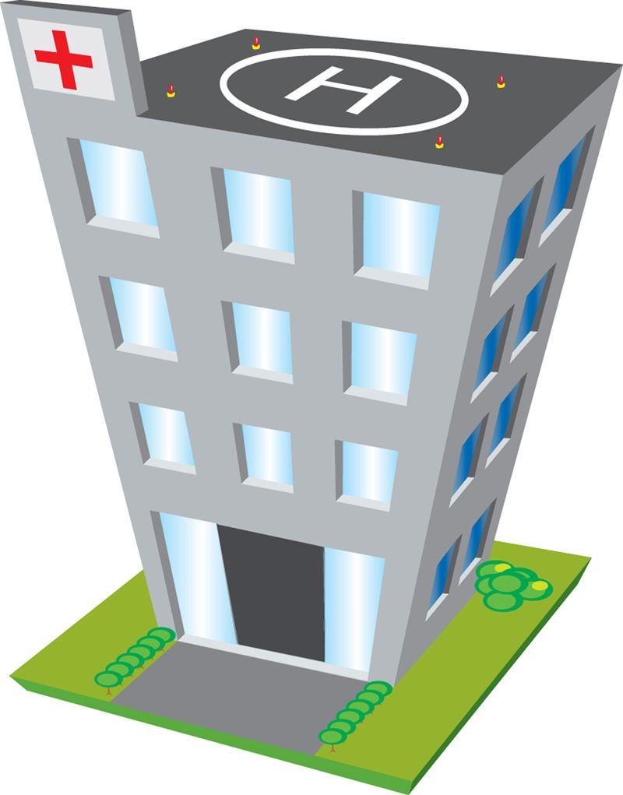
Performance Improvement
Use hospital-specific or
collaborative-based
performance improvement
initiatives in which
multifaceted strategies are
"bundled" together to improve
compliance with evidence-
based recommended practices

Slide 33
Performance Improvement
Clinical decision makers, healthcare payers, and patient safety advocates emphasize the importance of translating research findings into everyday practice
Rigorous evaluations of CRBSI preventive practices using study designs with high internal validity and including study populations that optimize external validity remain necessary
Once practices have been determined to be effective and economically efficient, the next step is to implement these evidence-based practices so they become part of routine clinical care
Unfortunately, implementation of evidence- based CRBSI preventive practices in U.S. hospitals has been suboptimal

Slide 34
Performance Improvement
In a national survey conducted in March 2005 of over 700 U.S. hospitals, approximately one quarter of U.S. hospitals indicated that either maximal sterile barrier precautions during central line insertion or chlorhexidine gluconate as site disinfectant, two practices widely recommended in the guidelines published in 2002, were not being used routinely
Approximately 15% of U.S. hospitals reported routinely changing CVCs to prevent infection despite evidence that this practice should no longer be used

Slide 35
Performance Improvement
Numerous quality improvement studies have been published during the past several years that have used various methods, such as education of healthcare personnel, audit and feedback, organizational change, and clinical reminders
The educational interventions primarily targeted hand hygiene, use of maximal sterile barriers during insertion, appropriate insertion site selection, proper site care using chlorhexidine gluconate, and prompt removal of unnecessary catheters

Slide 36
Performance Improvement
While a large number of before-and-after studies with a few using concurrent control groups have been published, no randomized, controlled trial evaluating a quality improvement strategy to prevent CRBSI has been reported
The vast majority of before-and-after studies reported statistically significant decreases in CRBSI rates after a quality improvement strategy was implemented

Slide 37
Performance Improvement
In addition to educating clinicians about CRBSI prevention, evidence-based interventions include:
a central venous catheter cart that contains all the necessary supplies
a checklist to ensure adherence to proper practices;
stoppage of procedures in non-emergent situations, if evidence- based practices were not being followed;
prompt removal of unnecessary central catheters identified during daily patient rounds;

Slide 38
Performance Improvement
5) feedback to the clinical teams regarding the number of CRBSI episodes and
overall rates; and
6) buy-in from the chief executive officers of the participating hospitals that
chlorhexidine gluconate products/solutions would be stocked
Using an interrupted time series analysis and multivariable regression, the investigators reported a statistically significant 66% decrease in CRBSI rates approximately 18 months after the intervention began and sustained reductions over time

Slide 39
Performance Improvement
Specific process and outcome measures for tracking and feedback (i.e rate of central line infections, proportion of central lines placed with all or individual bundle elements performed AND documented) should be identified in individual institutions based on areas that have been identified for performance improvement

Slide 40
Performance Improvement
Finally, emphasis on the care and maintenance of catheters once they are in place should be a focus of performance improvement and quality assurance in all programs
In one study:
Dressings (not intact) and caps (incorrectly placed) were identified as the major lapses in CVC care with 158 and 156 breaches per 1000 catheter days, respectively.
Interventions to improve reliability of care should focus on making the implementation of best practice easier to achieve

Slide 41
Infectious Disease Update: Managing Common Infections in the Nephrology Patient
Christopher W. Blackwell, Ph.D., ARNP, ANP-BC, CNE
Associate Professor and Coordinator of Nurse Practitioner Programs College of Nursing
University of Central Florida
Orlando, Florida

