Slide 1
  Risk Factors and Characteristics of Men Who Have Sex With Men Who Use the Internet to Meet Sexual Partners
Christopher W. Blackwell, Ph.D., ARNP, ANP-BC, CNE
Associate Professor and Coordinator of Nurse Practitioner Programs College of Nursing
University of Central Florida
Orlando, Florida
Sexual Science 2.0: Technological Innovations in Sexuality Research

Slide 2
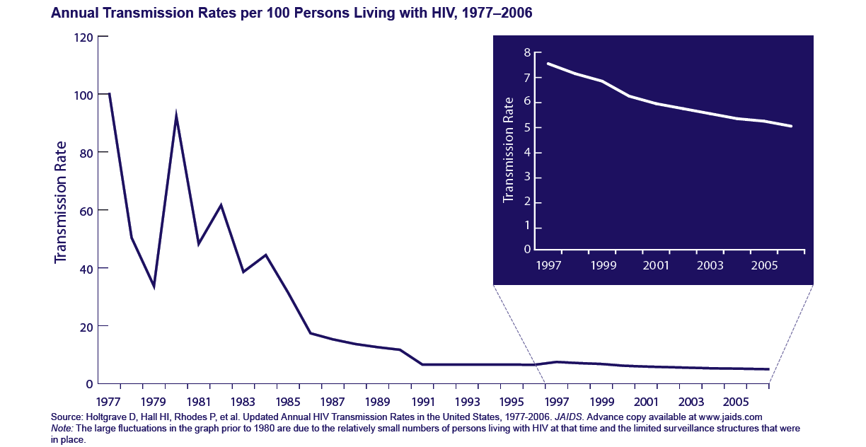
Introduction
Overall rates of HIV transmission in US ↓
Notes:
We can see from this graphical display, the overall rates of transmission of HIV in the US is down. In fact, over the past decade or so, the rates have remained relatively flat.

Slide 3
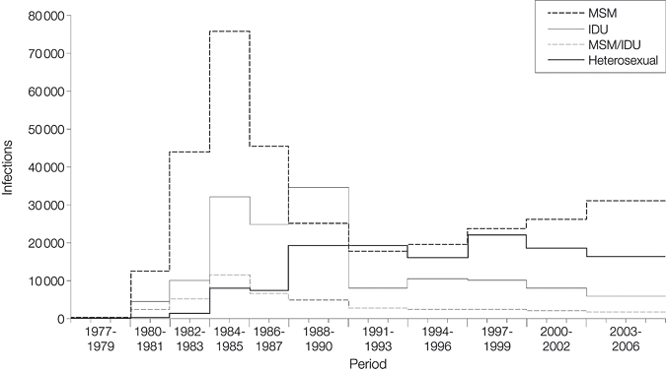
Introduction
Data show rates are increasing among MSM

Slide 4
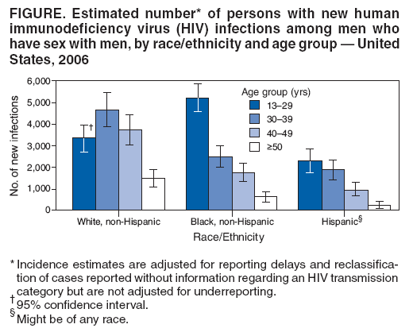
Introduction

Slide 5
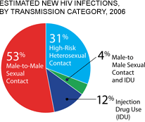
Introduction
53% of all new HIV infections (72% among men)
were attributable to male-to-male sexual contact.
Among white men, 81% of infections were linked
to male-to-male sexual activity, compared with 72%
among Hispanic/Latino men and 63% among black men.
Since whites make up a larger proportion of the total population, white men accounted for the greatest percentage of new infections among MSM at 46%, compared with 35% for blacks and 19% for Hispanics/Latinos.
Among white MSM, the infection rate was highest in the 30-39 age group, followed by the 40-49 age group.
In contrast, among black and Hispanic/Latino MSM, a majority of new infections occurred in the 13-29 age group.

Slide 6
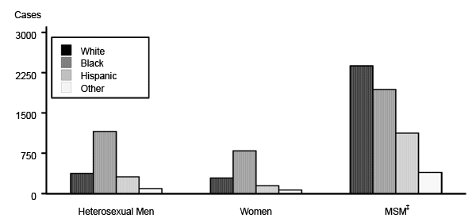
Introduction
Other sexually-transmitted infections (STIs) are also increasing among MSM:
Cases of syphilis among MSM are ↑:
  65% of all cases among MSM
  The overall rise in syphilis among all men is being attributed largely to the rise among MSM (CDC, 2007a)

Slide 7
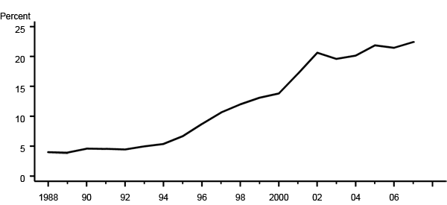
Introduction
Cases of Chlamydia among MSM are ↑
Cases of Gonorrhea among MSM are ↑:
Both Chlamydia and syphilis are associated with an increased risk of HIV transmission
Although HPV and HSV are not reported, the CDC (2007a) postulates rates of these infections among MSM are also ↑
Notes:
Figure BB. Gonococcal Isolate Surveillance Project (GISP) — Percent of urethral Neisseria gonorrhoeae isolates obtained from men who have sex with men attending STD clinics, 1988–2007.

Slide 8
Introduction
Cities with large populations of MSM, such as San Francisco, have shown a rise in the rates of infection with human immunodeficiency virus (HIV), syphilis, and rectal Chlamydia (San Francisco Department of Public Health, 2007).
What is responsible for these increases?
  Multiple etiologies have been proposed and not all indicate an increase in disease burden
Unprotected anal receptive and insertive intercourse remains the most risky behavior associated with HIV/STI transmission among MSM
Barebacking (condomless) sex is increasing, which is a major public health concern
Notes:
1. In other words, not all data indicate the reason why rates are increasing purely from increases in incidence but from improvement in surveillance methods. However, these are only partly responsible.

Slide 9
Introduction
Why is barebacking increasing?
Wolitski (2005) proposes 6 etiologic forces increasing the incidence of bareback (BB) sex among MSM:
  Improvements in HIV treatment
  More complex sexual decision making
  The Internet
  Substance use
  Safer sex fatigue
  Changes in HIV prevention programs.
Notes:
The use of sexual networking sites on the Internet to initiate sexual relationships among men who have sex with men (MSM) is an emerging phenomenon.

Slide 10
Introduction
Only 10% of heterosexual men use the Internet to find sexual partners.
This is in sharp contrast to the 43% of MSM who report doing so (Bolding, Davis, Hart, Sherr, and Elford, 2006).
MSM who use the Internet to initiate sexual relationships are more likely to engage in unsafe sexual practices (Benotsch, Kalichman, & Cage, 2002; Hospers, Harterink, van den Hoek, & Veenstra, 2002; Liau, et. al, 2006).
In a study conducted by Hospers, et. al. (2006), 30% of the MSM who engaged in sexual activity with other MSM met through the Internet reported inconsistent safer sexual behaviors.

Slide 11
Introduction
Another study showed 43% of MSM who engaged in BB sex with men they met over the Internet did so without knowledge of that individual’s HIV serostatus (Halkitis & Parsons, 2003).
While data do not support the widespread intentional transmission of HIV among HIV-positive individuals to HIV-negative partners (Tewksbury, 2003), findings from the few studies assessing the risks among MSM using the Internet to initiate sexual activity highlight the need for critical inquiries which examine specific sexual behaviors and the possible role these behaviors can play in the transmission of STIs, especially HIV.

Slide 12
Methods
Purpose of Study
  The purpose of this study was to determine if an association exists between a request for BB sex and self-reported HIV serostatus among MSM using a popular Internet sexual networking site.
  Specifically, the association between requests for BB sex was assessed in-relation to each of three individual profile response classifications:
    1) HIV- negative serostatus
    2) HIV-positive serostatus
    3) unknown/ non-disclosed HIV serostatus.

Slide 13
Methods
Methods, Sample, and Protection of Human Subjects:
  The study was approved by the Institutional Review Board of the University of Central Florida. No personal identifying information was collected and at no time did interaction occur with the individuals using the site. All subjects were coded with a unique identifier.
  Sampling for this study occurred over a period of approximately 30 days. Subjects were from seven geographical locations in Florida who accessed a popular Internet sexual networking site.
  Each region was sampled until either every profile meeting inclusion criteria was sampled, or a particular region reached a sample size of approximately 100.
  Only profiles of MSM who were actually on-line during data collection were included; couples seeking sexual relationships were excluded.
  Data related to HIV serostatus, requests for BB sex, and requests for safe sex were collected from the user profiles.
  Profile user names were recorded to ensure profiles were not double-sampled due to time elapse between data collection periods.

Slide 14
Methods
Data Analysis:
  Profile data were coded and input into a database using the Statistical Program for the Social Sciences (SPSS) 16.0
  Demographic data were analyzed with descriptive statistics.
  To assess the relationship between requests for safe sex only, bareback sex, and HIV serostatus, Pearson Chi-Square analyses were conducted.

Slide 15
Results
Findings:
  The final sample consisted of 483 MSM.
  The typical subject was a white male, 31-40 years of age, who reported being HIV negative, and did not request safe sex only.
  Table 1 depicts the sample characteristics

Slide 16
Region Orlando Miami Tampa Ft. Lauderdale Florida Panhandle Jacksonville Florida Keys | 101 (20.9%) 100 (20.7%) 101 (20.9%) 100 (20.7%) 30 (6.2%) 21 (4.3%) 30 (6.2%)
Age 18-30 31-40 Over 40 | 144 (29.8%) 180 (37.3%) 159 (32.9%)
Self-Report HIV status Negative Positive Not disclosed | 330 (68.3%) 27 (5.6%) 126 (26.1%)
Ethnicity White Black Hispanic Other/not disclosed | 259 (53.6%) 17 (3.5%) 68 (14.1%) 139 (28.8%)
Safe Sex Only Request (entire sample) Yes No | 160 (33.1%) 323 (66.9%)
Safe Sex Only Request (by HIV serostatus classification) Yes- HIV + Yes- unknown/undisclosed serostatus Yes- HIV - No- HIV + No- unknown/undisclosed serostatus No- HIV - | 4 (14.8%) 10 (7.9%) 146 (44.2%) 23 (85.2%) 116 (35.9%) 184 (55.8%)
Bareback Sex Requested Yes/ No | 11 (2.3%)/ 472 (97.7%)

Slide 17
Results
  Only 11 individuals (2.3%) requested bareback sex.
  Only one-third of the sample requested safe sex only:
    When evaluated according to HIV serostatus, those that were HIV negative requested safe sex 44% of the time compared to only 15% of HIV positive individuals and 8% of individuals with unknown or unreported HIV status.
  Findings were statistically different (Chi 2=58.585, df 2, p=.000).
  Of the 11 requesting BB sex:
    Those HIV negative requested BB sex only 0.6% of the time compared to 11.1% of those HIV positive and 4.8% of those with unknown or not disclosed status.
  Findings were significantly different (Chi 2=17.104, df 2, p=.000).

Slide 18
Discussion & Clinical Recommendations
Sample Characteristics:
  While earlier studies suggest MSM using the Internet to meet sexual partners do not disclose their HIV serostatus or report their HIV serostatus as unknown, the findings from this study indicate a higher overall percentage of this than prior ones.
  Tewksbury (2005) found only 10% of the sample either did not disclose HIV serostatus or reported their HIV serostatus as unknown. In contrast, this analysis suggests a much greater number of MSM as either not reporting their HIV status or indicating unknown serostatus (0.4% and 24.8% respectively).
  This could indicate a regional variance due to the scope of this study consisting of MSM only in Florida.
  Or, this could also suggest MSM who use the Internet to initiate sexual relationships fear disenfranchising potential sexual partners by disclosing their HIV-serostatus.
  Dawson, et. al. (2005) postulated MSM who use the Internet to initiate sexual relationships may find it socially and legally safer to not disclose their HIV serostatus than to state their serostatus, or identify a preference for a partner with a particular HIV serostatus.

Slide 19
Discussion & Clinical Recommendations
Because MSM comprise the highest risk group for HIV acquisition and transmission (CDC, 2005), it is imperative for MSM to undergo routine screening for HIV (CDC, 2007b). At least annual screening.
In addition, clinicians should encourage MSM to disclose their HIV serostatus to potential sexual partners.
Up to 10% of the United States population identifies their sexual orientation as one other than heterosexual (Seidel, et. al, 2006).
Therefore, clinicians should be non-judgmental in their approach to history-taking and reassure the client of the confidentiality of the provider-client relationship.

Slide 20
Discussion & Clinical Recommendations
If a male client reports sexual relationships with other men, the provider should determine the date and results of his last HIV screening.
If the patient has not had an HIV screening in the previous 12 months, he should be referred to a screening center.
Cities with large populations of MSM often offer free HIV screenings and even point-of-service tests which can be interpreted in as little as 15 to20 minutes (CDC, 2007b).
Local health departments and gay, lesbian, bisexual, and transgender community centers are excellent clinical resources to assist in identifying such locations.
Here in Orlando, the GLBCC (946 N Mills Ave) offers free POS HIV testing every Wed from 12:00-7:00 pm by appt. (407) 228-8272
In addition, providers should ascertain if their MSM clients use Internet sexual networking sites to find partners and whether or not they disclose their HIV serostatus to partners met on-line and their consistent use of safer sex practices, particularly, the regular use of condoms during anal intercourse.

Slide 21
Discussion & Clinical Recommendations
The Relationship Between BB Sex and HIV Serostatus:
  The findings of this study indicate a statistically significant relationship between HIV serostatus and requests for bareback sex.
  Although the requests were few, most of the requests came from HIV positive or unknown/not disclosed HIV status individuals.
  While it is important to emphasize that MSM who know they are HIV-positive are more likely to engage in safer sex practices to protect their sexual partners (CDC, 2007c), these findings are consistent with some earlier inquires which have suggested HIV-positive men may misrepresent their HIV serostatus or participate in higher-risk behaviors when using the Internet to initiate sexual relationships (Laumann & Youm, 1999; Ross, et. al., 2006).

Slide 22
Discussion & Clinical Recommendations
Another significant finding in this study is the number of MSM who specifically requested safe sex only in their profile:
  Only one-third requested safe sex.
  Those who were HIV negative requested safe sex more often; however, it was less than half of the time.
  Safe sex requests from HIV positive and unknown/not disclosed individuals were made 15% of the time or less.
  No prior studies have assessed the relationship between requests for safe sex and HIV serostatus or risk.
  Failure to request safe sex only within a profile doesn’t necessarily indicate an individual won’t participate in safer sex practices.
  However, this finding highlights the possibility of safer sex fatigue among MSM, particularly those using the Internet to initiate sexual relationships.
  Also, because there were statistically significant differences among those HIV-negative and those of either HIV-positive, unknown, or undisclosed HIV serostatus, this might suggest higher risk activity among MSM who are HIV-positive or of unknown/ undisclosed HIV serostatus.
  This also proposes the possibility of a higher likelihood of HIV serodiscordance among MSM using the Internet to initiate sexual relationships.

Slide 23
Discussion & Clinical Recommendations
Previous research suggests Caucasian MSM who are HIV-positive are more likely to seek-out partners who are serocordant while Africans Americans are less likely to do so (Laumann & Young, 1999).
Ethnicity was examined within this study, but the number of requests for BB sex was too small to make any statistically sound conclusions.
While low-risk partner to low-risk partner activities carry the least chance of HIV transmission, high-risk to high-risk partner sexual activity is not necessarily safer (Halkitis & Parsons, 2003).
There is a possible false perception that unprotected anal intercourse between two HIV-positive men is not a risky behavior.

Slide 24
Discussion & Clinical Recommendations
However, disease progression can be greatly accelerated with the introduction of more HIV viral particles from an infected partner (raising an individual’s HIV viral load); and the opportunities for the introduction of drug-resistant mosaic HIV strains is a significant reality (Ramos, et. al, 1999).
It is essential for clinicians to educate HIV-positive patients about safer sex practices and emphasize the consistent use of condoms during anal intercourse, even when the partner is also infected.
Patients should be taught the pathophysiology of HIV replication and should be given information about the role unsafe sexual behaviors might play in the development of resistant strains of HIV.
Patients should be aware that exposures to other individuals’ HIV viral particles through semen could potentially increase their viral load and expedite their disease process and/or progression to AIDS.

Slide 25
Discussion & Clinical Recommendations
Clinicians should encourage all MSM to request safe sex practices and to be open in their discussions with potential partners about the importance of the use of condoms during anal receptive intercourse.
Because HIV antibodies can take up to six months to react with standard HIV screening tests (CDC, 2007b), clients should be aware that HIV serostatus is not an absolute certainty and that reporting of a negative HIV serostatus within an Internet profile doesn’t necessarily mean an individual is HIV negative.
Clinicians should provide positive reinforcement to clients who report safer sex practices and who request safer sex practices from potential partners.

Slide 26
Discussion & Clinical Recommendations
Implications for Public Health
  A recent article in the American Journal of Men’s Health (Blackwell, 2008) provided several public health strategies which might promote safer sex practices among MSM who use the Internet to initiate sexual relationships.
  In response to an outbreak of syphilis among MSM using the Internet to meet sexual partners in San Francisco in 2002, the Department of Public Health designed a plan to introduce prevention strategies in on-line environments.
  Public health officials identified the three most frequented Internet sexual networking sites and paid for banners and advertisements and site-specific warnings to inform users of the outbreak.
  In addition, a Web site was created that included interactive chats with physicians and nurse practitioners.
  Users could ask questions completely anonymously and providers could provide information on a wide-range of sexually-related topics, including sexually-transmitted infections and prevention strategies (Klausner, et. al, 2004).

Slide 27
Discussion & Clinical Recommendations
  Users could also request a completely anonymous syphilis screening slip (coded with a unique identification number) which could be printed and brought to a participating clinic for screening; results were then posted on-line using only the individual’s user identification number.
  Appropriate information regarding treatment and follow-up was also provided on-line.
  While HIV is still considered a notifiable disease, how the disease is reported can vary by location and by state health department (CDC, 2009b).
  Therefore, it is possible that public health professionals could vary approaches like the one employed in San Francisco to combat their syphilis outbreak.

Slide 28
Discussion & Clinical Recommendations
  Patients could visit an informative web site to obtain information about behaviors which increase the risk for HIV transmission and using a chat or discussion form could post questions anonymously to physicians, nurse practitioners, and physician assistants.
  Users could also print a form that would allow anonymous testing at various locations using a unique identification number.
  Then, results could be posted on a web site using the unique identification number.
  Appropriate follow-up, consultation, and referral service information could also be provided to the user using this same site.

Slide 29
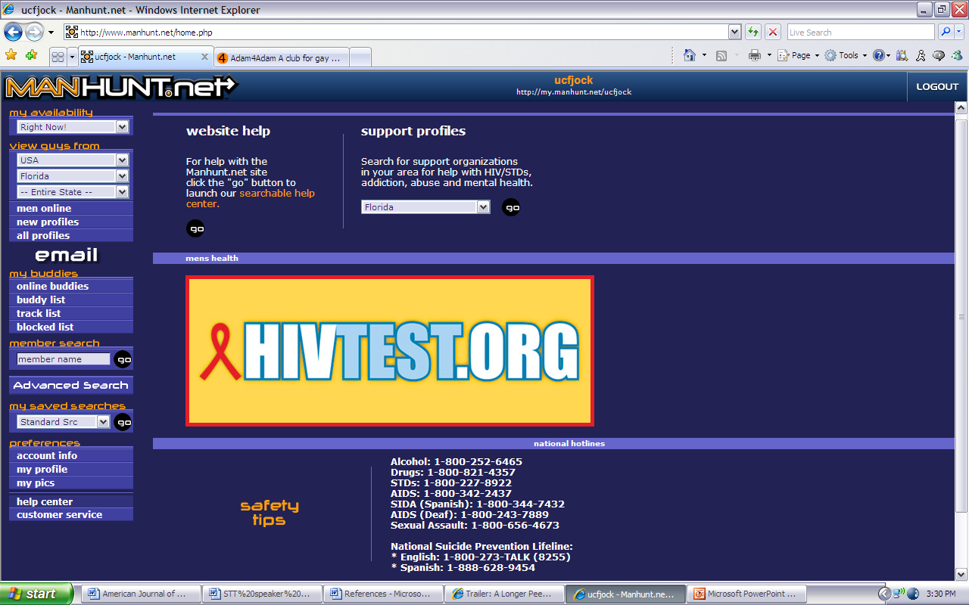
Discussion & Clinical Recommendations

Slide 30
Summary, Limitations, Conclusions
The use of Internet sexual networking sites is becoming a more prominent means for MSM to initiate sexual relationships.
The widespread use of such sites provides quick and anonymous access to the initiation of sexual relationships, which research suggests can make an impact on sexual decision making.
Clinicians should consider the possible use of Internet sexual networking sites when discussing safer sex practices with their MSM clients and ensure their MSM clients are routinely screened for HIV and understand the importance of disclosing their HIV serostatus to potential sexual partners, including those met in the on-line environment.

Slide 31
Summary, Limitations, Conclusions
In addition, HIV-positive MSM should be educated about their HIV disease process and the risks associated with serocordant sexual relationships, including the risk of increasing HIV viral load and introduction of drug-resistant HIV mosaic strains.
Specific public health strategies, including the use of banners and other advertisements on Internet sexual networking sites, the creation of educational Web sites encouraging dialogue among MSM and health professionals regarding STI transmission and risk, and means for Internet-mediated anonymous HIV screening were discussed.

Slide 32
Summary, Limitations, Conclusions
It is imperative to consider that not all profile information is necessarily factual and accurate. Requesting specific sexual activities in an Internet-based profile does not necessarily support that such activities will occur during sexual encounters.
Perhaps the most significant study limitation is the generalizability of results:
  This study consisted only of MSM using Internet sexual networking sites within the State of Florida.
  Future research should approach this issue from a more national perspective and determine the etiology of requesting unsafe sexual behaviors among MSM using the Internet to initiate sexual relationships.

Slide 33
  Risk Factors and Characteristics of Men Who Have Sex With Men Who Use the Internet to Meet Sexual Partners
Christopher W. Blackwell, Ph.D., ARNP, ANP-BC, CNE
Associate Professor and Coordinator of Nurse Practitioner Programs College of Nursing
University of Central Florida
Orlando, Florida
Sexual Science 2.0: Technological Innovations in Sexuality Research

